Slide 1
Web Server Deployment
using CI/CD pipeline

Slide 2
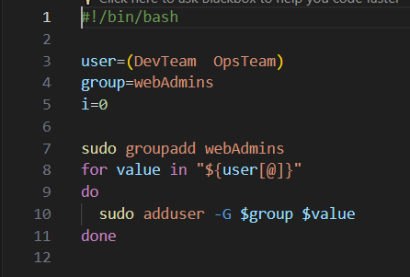
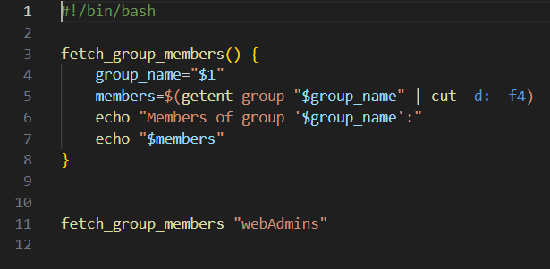
Bash script
Add users script
Fitch group members script

Slide 3
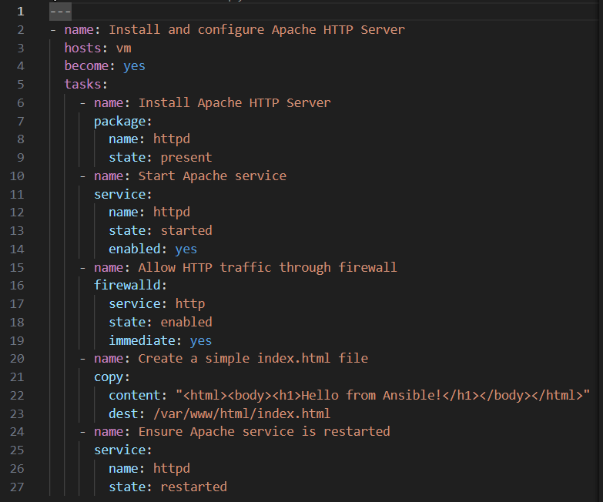
Ansible playbook
The playbook consists of several tasks, each performing a specific action, starting with the installation and configuration then creating a simple html file shows “hello from ansible!” when the server open.

Slide 4
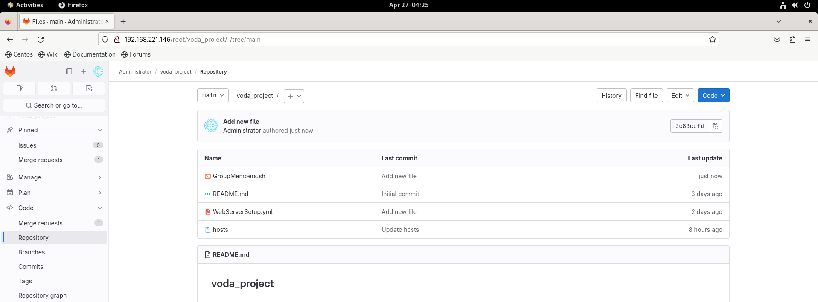
Gitlab server
After installing the gitlab and configure it , I made the repo where the project will be .
Then configured the integration of Jenkins with gitlab.

Slide 5
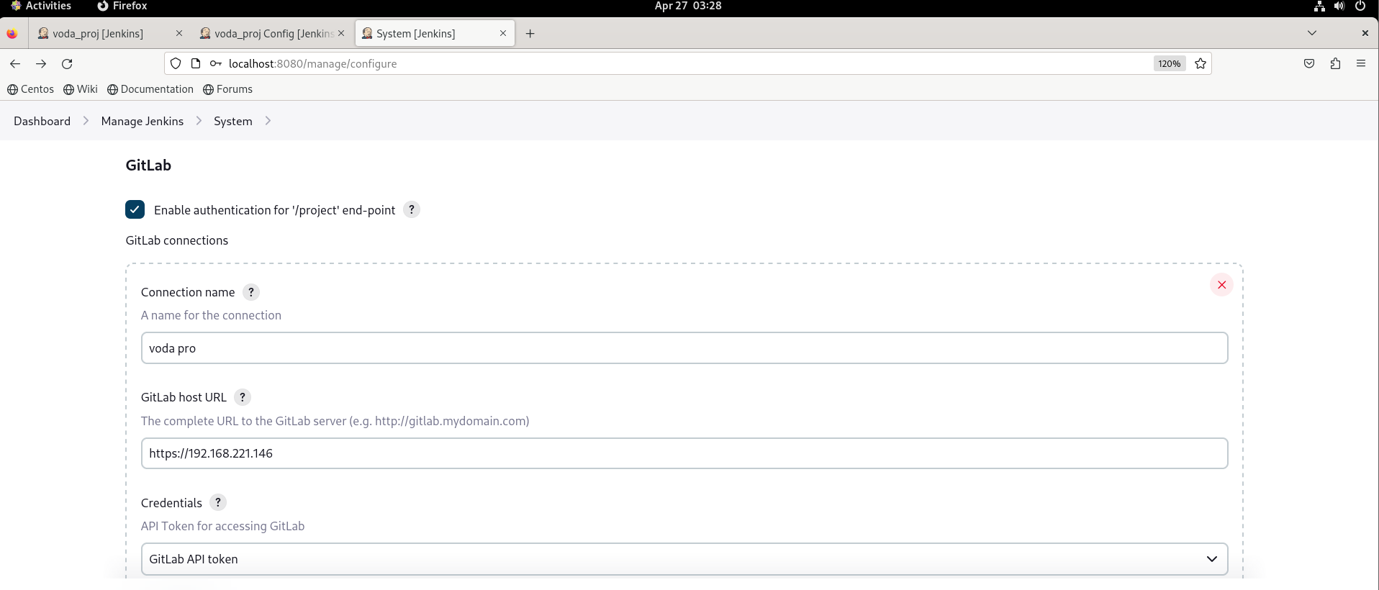
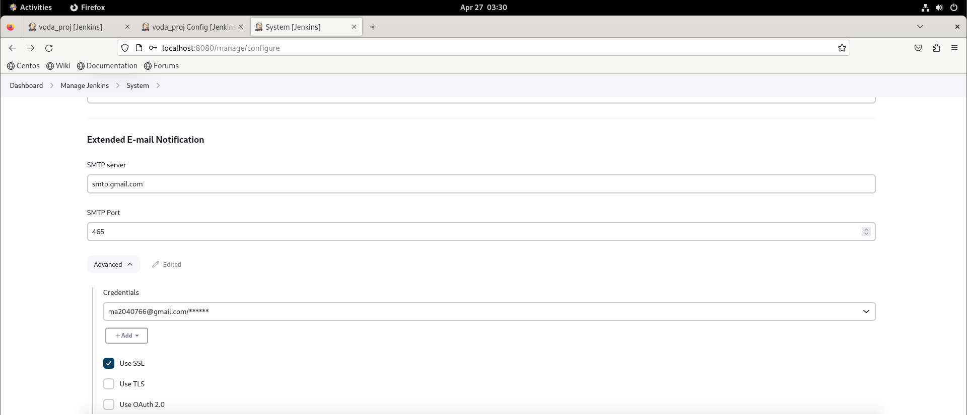
Jenkins server
Gitlab connection
Email notification configuration

Slide 6
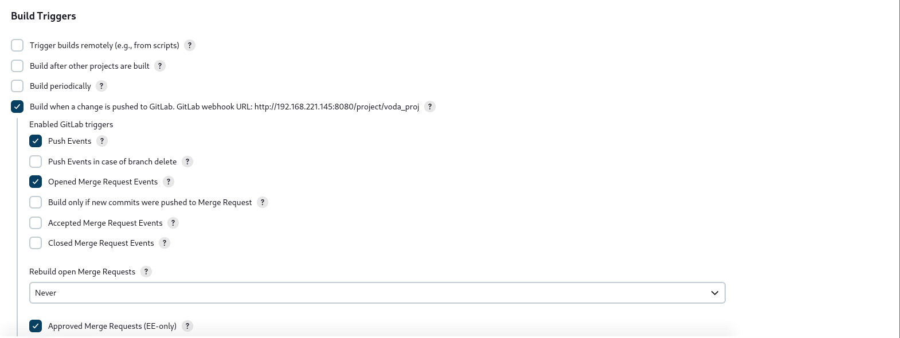
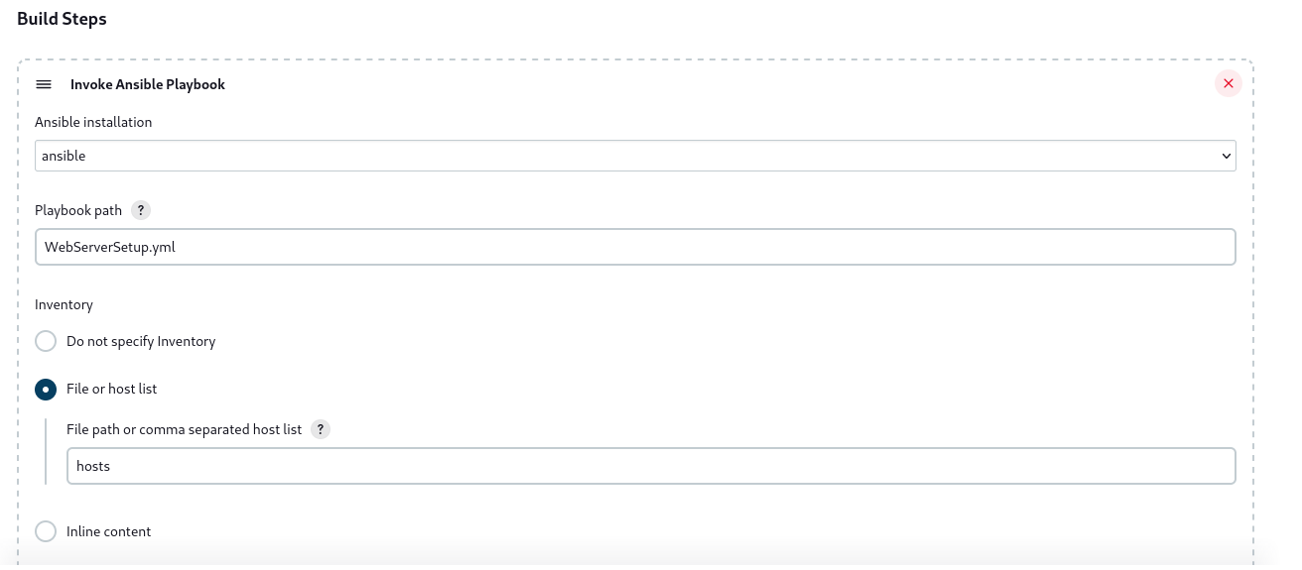
Freestyle job

Slide 7
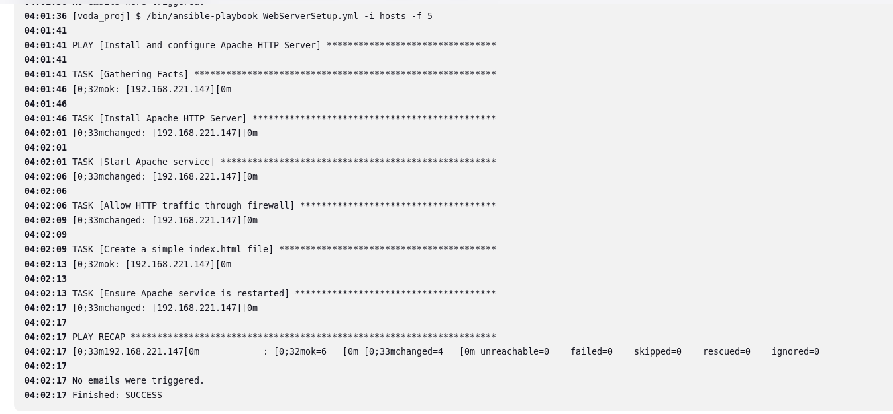
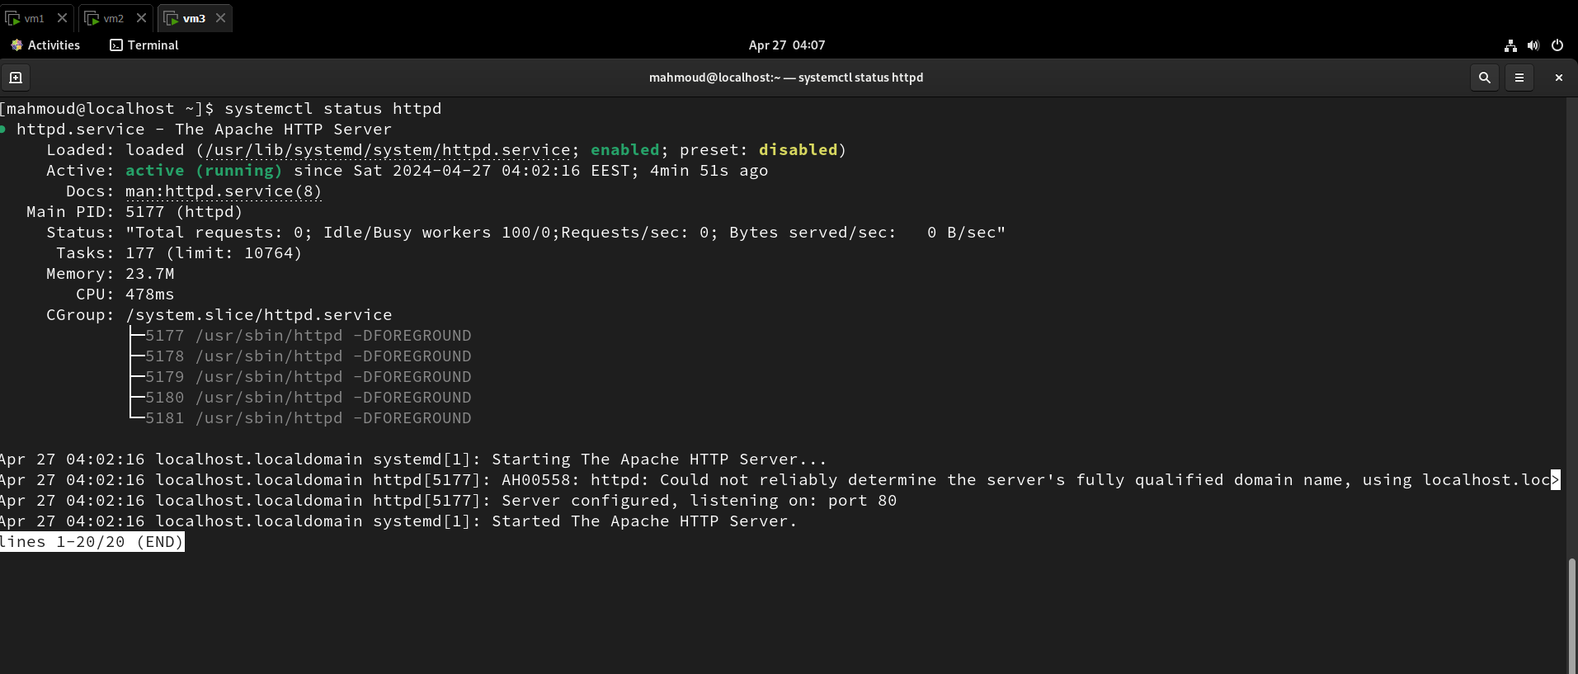
In case of success :

Slide 8
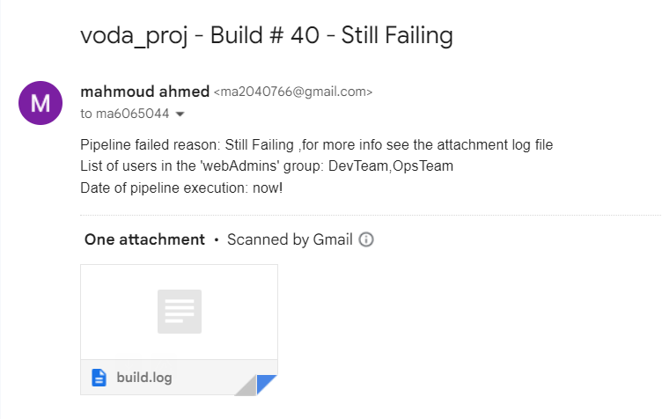
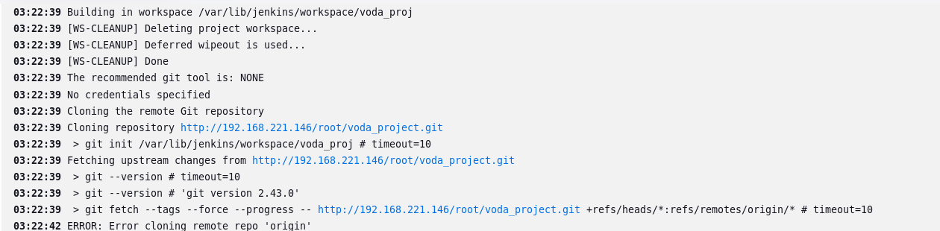

In case of failure :

